Slide 1
CLASSICAL MECHANICS AND SYMPLECTIC GEOMETRY
Renqing Luo

Slide 2

ESSENTIAL
Lagrangian Mechanics
Hamiltonian Mechanics
Tangent Bundle
Configuration Space
Cotangent Bundle
Phase Space

Slide 3
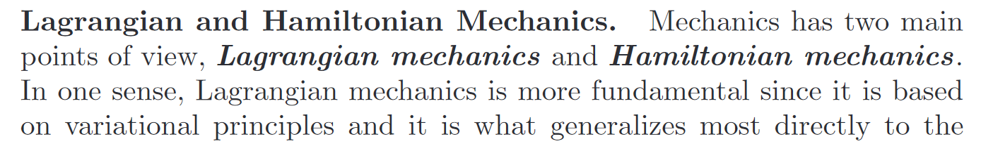
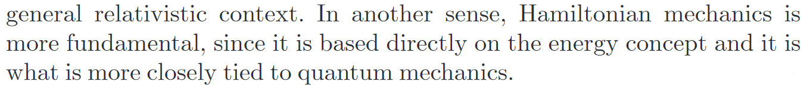
I N T R O D U C T I O N

Slide 4
Newtonian mechanics can solve all the dynamic problems in the classical particle system, but there is a problem here: constraints. When there are constraints, Newton's method requires us to express the constraints in a geometric way. Each constraint must be represented by an equation, so the equations = primes × dimensions + constraints.
In the Lagrangian equation, through the generalized coordinates, we directly eliminate the constraints from the variable, and the constraints no longer need any equation expression, so the equations = generalized coordinates = primes × dimensions - constraints. From this point of view, the Lagrangian equation is much simpler and more natural, because the constraint should be used to reduce the degrees of freedom, and it should reduce the number of equations. Essentially, Newton's law only describes the motion of the particle system in Euclidean space, while the constraint relationship expresses a submanifold in the product topology of the particle system motion. Lagrange has been a problem in the generalized coordinate space. To allow this space to exist, the restriction is a lot. First, the constraint must be holonomic. If the constraints are not holonomic, the more equations are needed.
Therefore, the phase space of Hamiltonian mechanics puts the generalized momentum and the generalized coordinates in the same position, instead of the generalized velocity in the Lagrangian equation, which is the derivative of the generalized coordinates. This makes the geometric constraint and the differential constraint indistinguishable. As long as it is guaranteed that the generalized momentum and the generalized coordinates are canonical symplectic form. Although the number of equations are increased, the equations are reduced by one degree at the same time, which makes mathematical much more convenient. Many differential equations are qualitative. The equations that can be solved analytically, the Hamiltonian equation does not have any advantage, but it make things complicated. It is not as good as the Lagrangian equation, but when there is no analytical solution, we can gain a lot information by using the Hamiltonian without solving the equation. In addition, the Poisson brackets in Hamiltonian can determine the conserved quantities, corresponding to symplectic form in mathematics, which is the basis of symplectic geometry, and it is the commutation relation developed by it that is also very important for quantum mechanics.

Slide 5
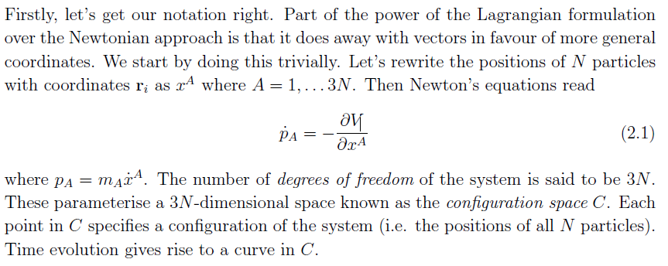
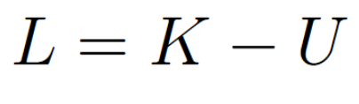
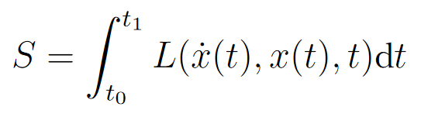
L A G R A N G I A N
Largrangian is the kinetic minus the potential energy of the particle. It depends on the position, the velocity, and time. We then define the action to be the integral of the Lagrangian over time.

Slide 6
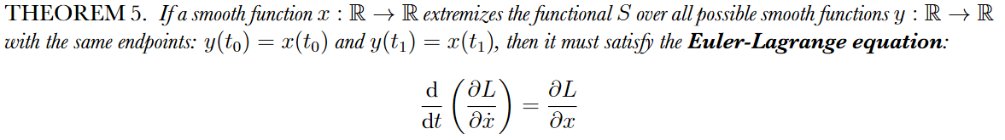
L A G R A N G I A N

Slide 7



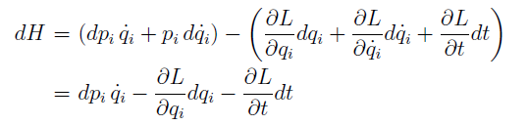
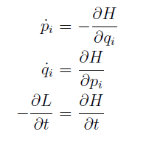
H A M I L T O N I A N

Slide 8
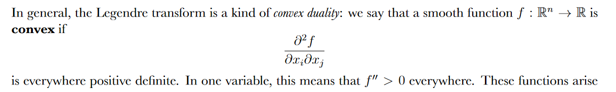
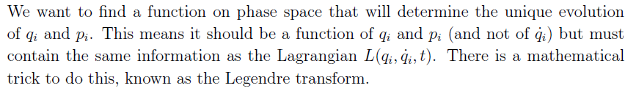
L E G E N D R E T R A N S F O R M

Slide 9

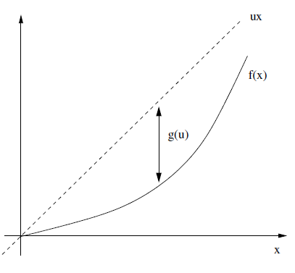





L E G E N D R E T R A N S F O R M

Slide 10
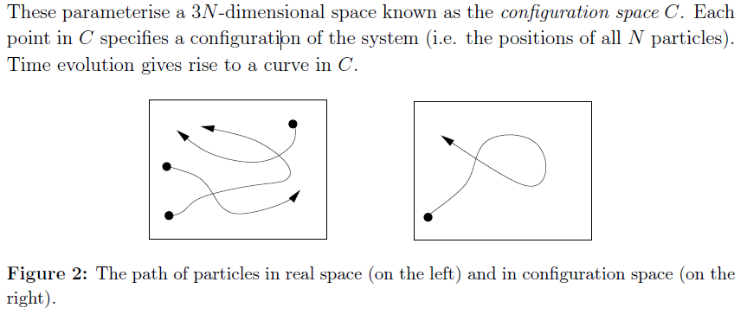
CONFIGURATION SPACE

Slide 11
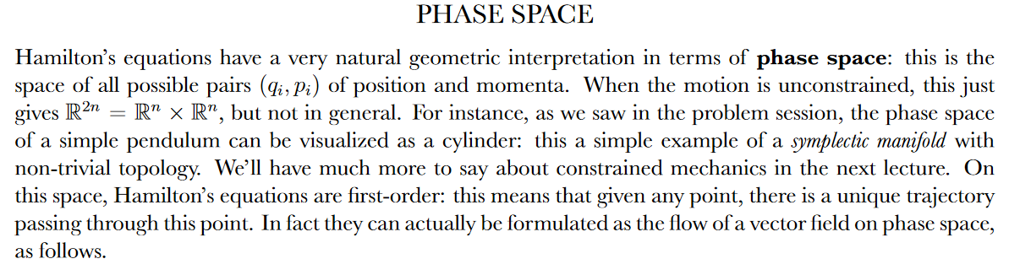
PHASE SPACE

Slide 12
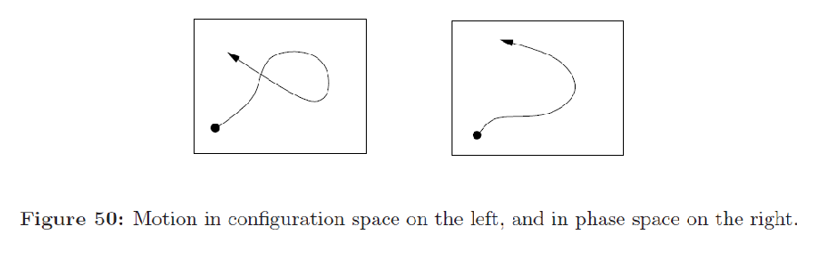
CONFIGURATION SPACE

Slide 13
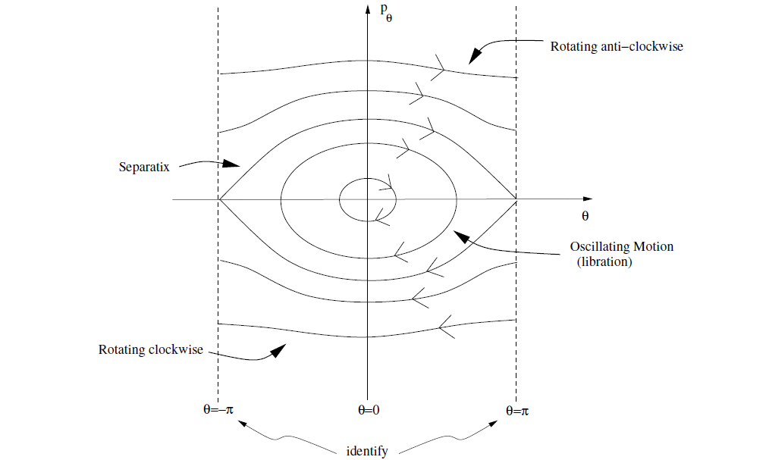
PHASE SPACE

Slide 14

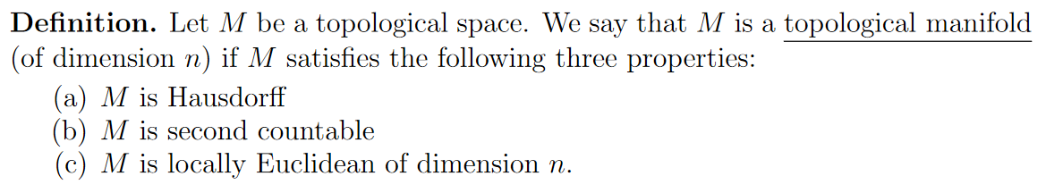

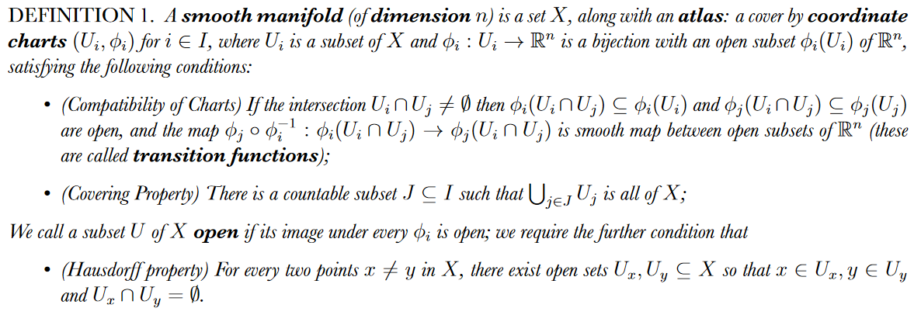
M A N I F O L D

Slide 15
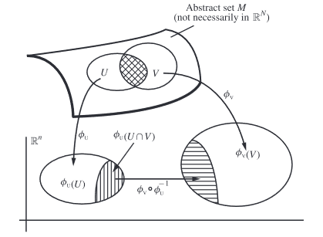
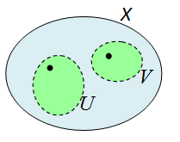
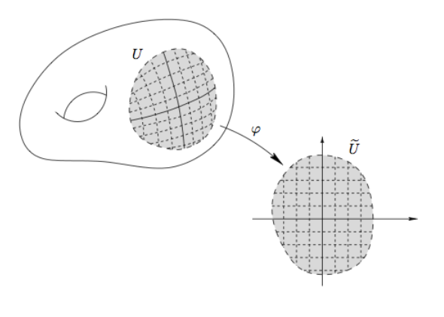
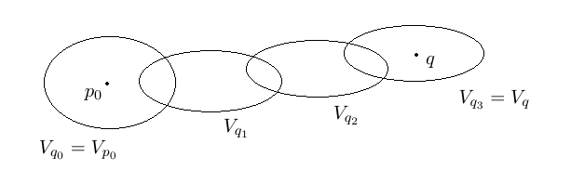
M A N I F O L D

Slide 16
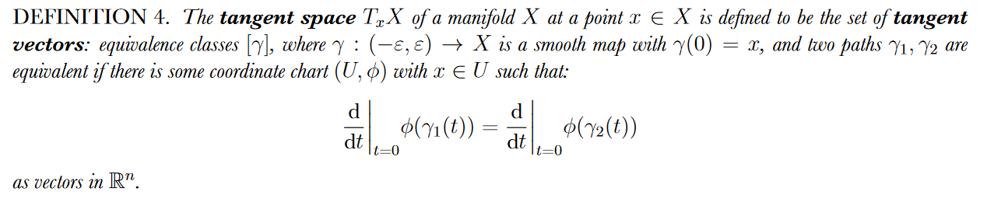
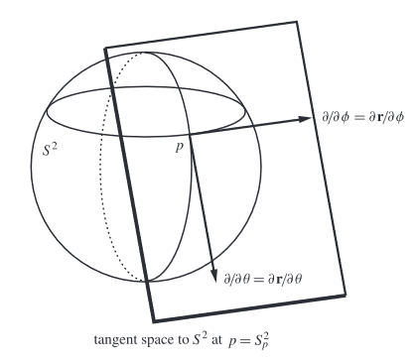
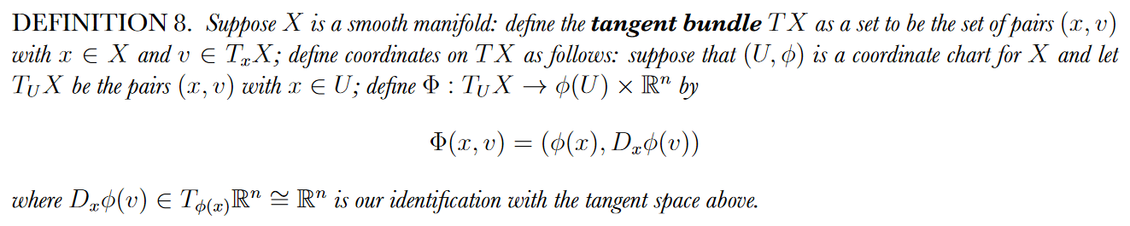
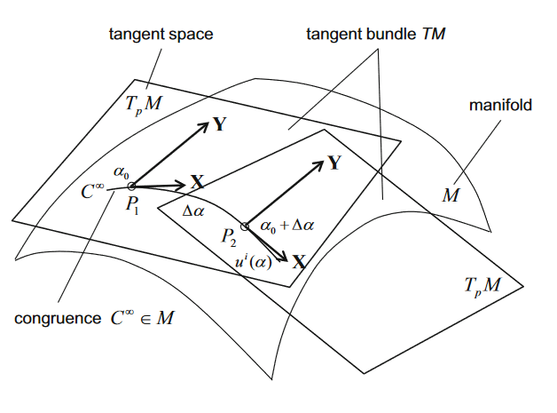
T A N G E N T B U N D L E

Slide 17
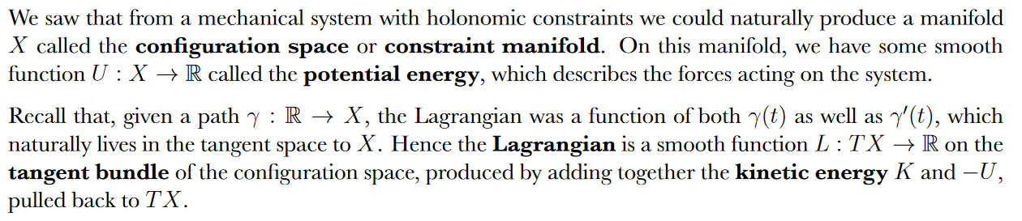
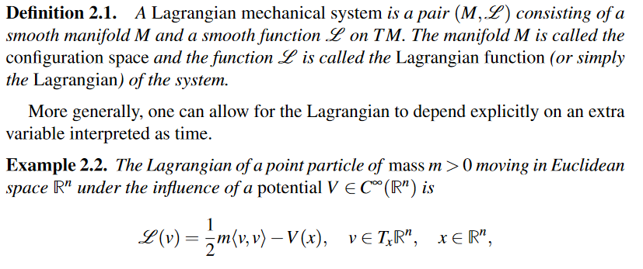
L A G R A N G I A N

Slide 18
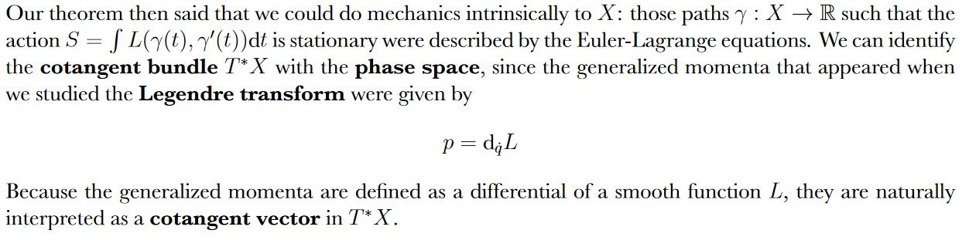
H A M I L T O N I A N

Slide 19
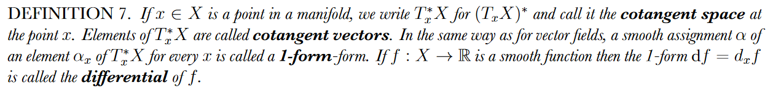
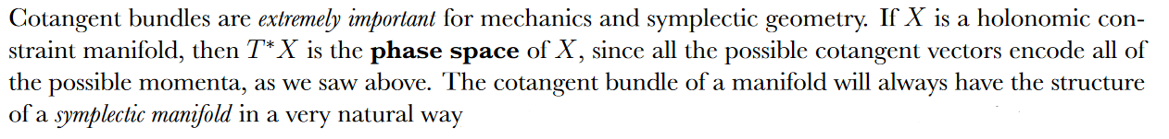
C O T A N G E N T B U N D L E

Slide 20
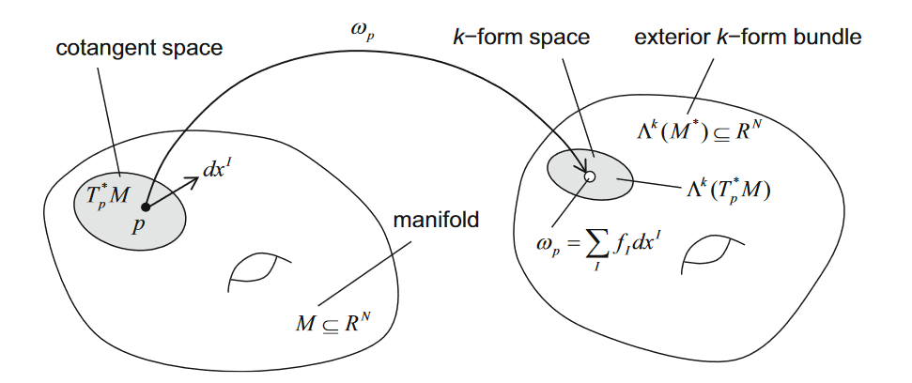
C O T A N G E N T B U N D L E

Slide 21
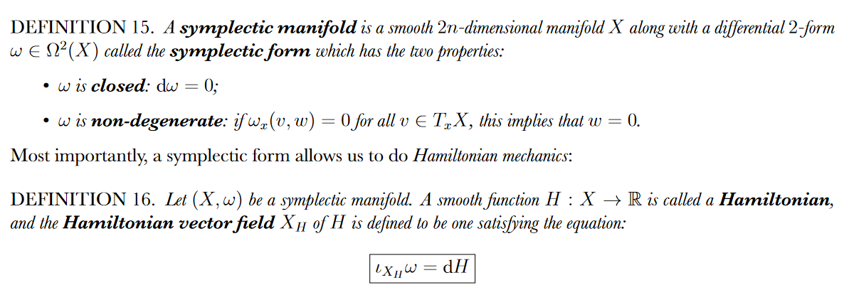
S Y M P L E C T I C M A N I F O L D S

Slide 22
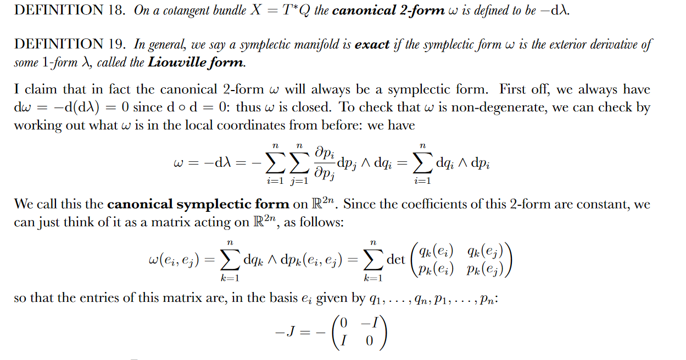

Slide 23
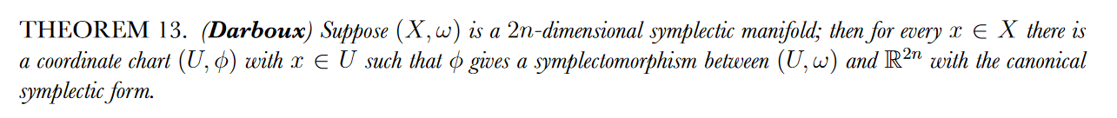
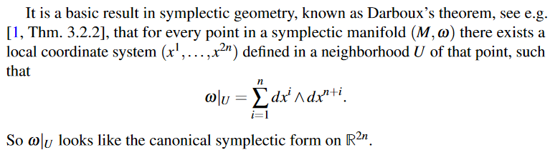
D A R B O U X

Slide 24
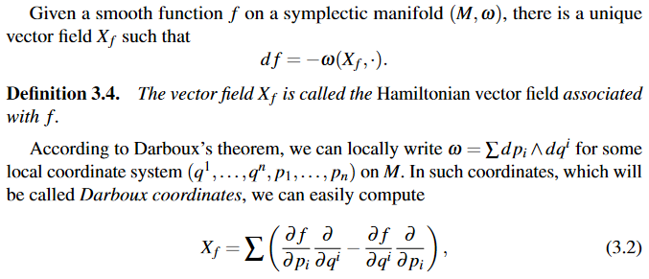
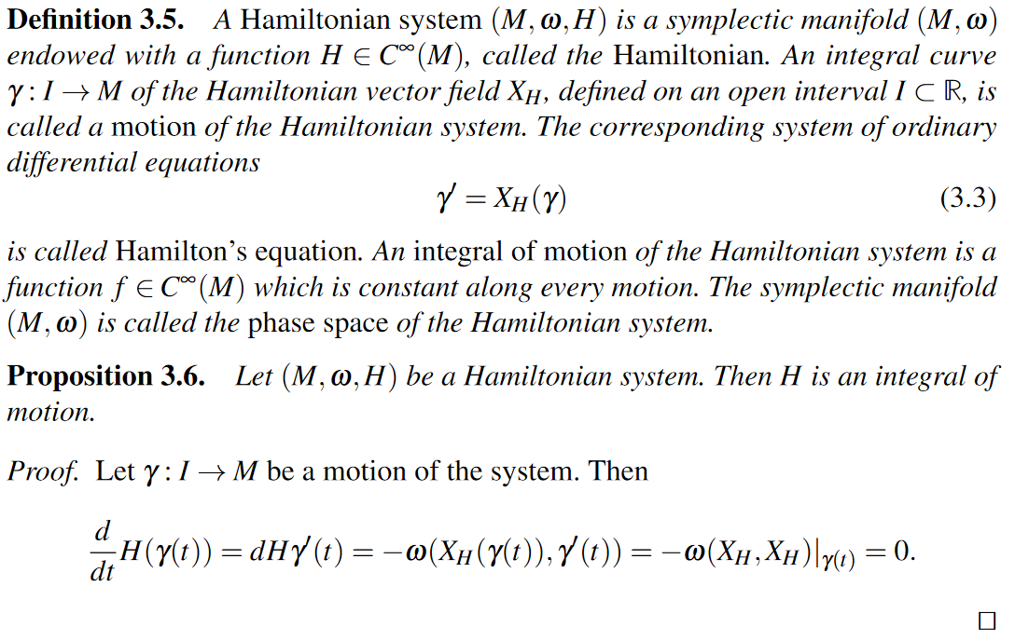
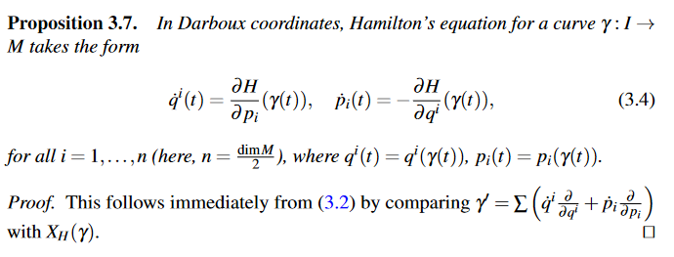
H A M I L T O N I A N

Slide 25


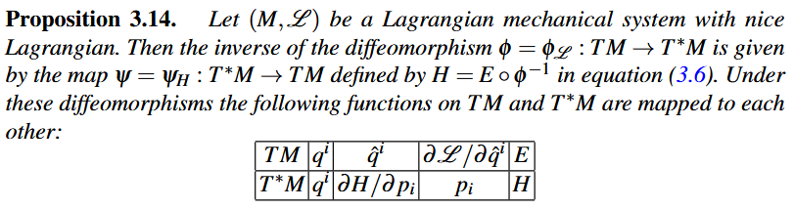

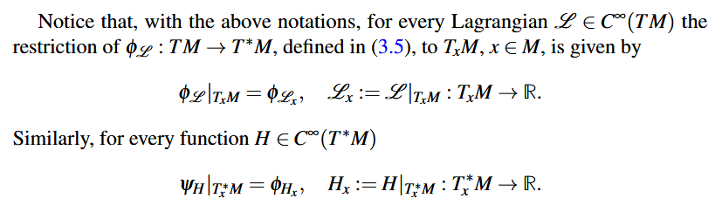
L E G E N D R E T R A N S F O R M

Slide 26
ESSENTIAL
Lagrangian Mechanics
Hamiltonian Mechanics
Tangent Bundle
Configuration Space
Cotangent Bundle
Phase Space

Slide 27
THANKS

Slide 28
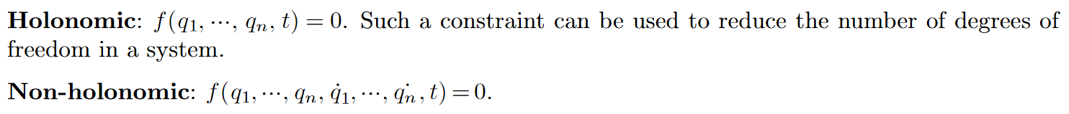
H O L O N O M I C C O N S T R A I N T

